Slide 1

Let it
Grow
by:
Salma Hossam
Anas Ayman
Salma AlWardany

Slide 2
Table of contents
01
02
Idea
Workflow
03
04
Methodology
Results

Slide 3

01
Idea
Problem Statement

Slide 4
Problem Statement
Sherif Hamdy
Software Engineer
Valeo

Slide 5

Karima Tawfiq
Doctor
Hospital
Sereen Atef
Avocat
International law
Amir Hassan
Logistics manager
Transportation company
Ahmed Essam
Accountant
Multinational company

Slide 6
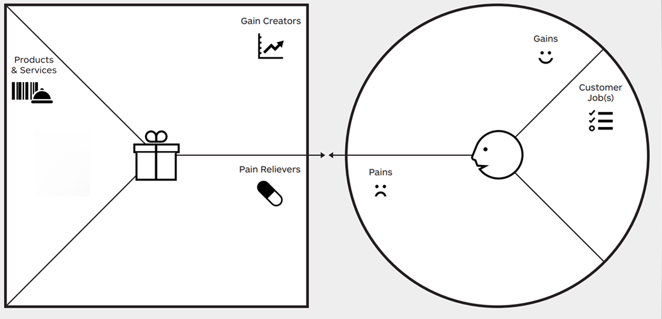
saving money
saving time
all resources in one place
save time
Save water
Save plants
Save money
active website and application
Easy to use hardware
All planting lovers
Plants are dead
Giving the plants water they need.
Notes:
Instructions to students:
Walk the audience through your VPC

Slide 7
01
Idea
Project Idea

Slide 8
Project Idea
Leveraging IoT technology, our smart irrigation system addresses the issue of improper plant watering. By integrating open-source platforms and applications, the system monitors soil moisture and temperature, activating the water pump, as necessary. This not only prevents overwatering but also reduces water waste commonly seen in traditional timed irrigation practices, as the system halts pumping once optimal soil moisture is achieved.

Slide 9
Methodology
02
Main Components
Raspberry Pi
Adafruit Web Dashboard
Blynk Mobile App

Slide 10
Smart Irrigation System Components
Raspberry Pi
Adafruit Web Dashboard
Blynk Mobile App

Slide 11
Smart Irrigation System Components
Operational Modes
Automatic Mode
Manual Mode
Adafruit Dashboard Features
Operation Mode and Pump Status Indicator.
Humidity and soil moisture levels.
System Temperature Indicator
Battery Level Indicator
Temperature Gauge
Raspberry Pi
Adafruit Web Dashboard
Blynk Mobile App

Slide 12
Smart Irrigation System Components
Operational Modes
Automatic Mode
Manual Mode
Adafruit Dashboard Features
Operation Mode and Pump Status Indicator.
Humidity and soil moisture levels.
System Temperature Indicator
Battery Level Indicator
Temperature Gauge
Raspberry Pi Zero
Battery 12v 10000mAh
DS1307 RTC
DC Step Down Converter
Waterproof Electrical Box
Pump
Temperature and Humidity Sensor
Soil Moisture Sensor
Battery Protection Module
Relay Module (12V-10A) 1Channel
Voltage and Current Sensor Module
Battery Level Indicator Module 1S-8S (General Version)
Raspberry Pi
Adafruit Web Dashboard
Blynk Mobile App

Slide 13
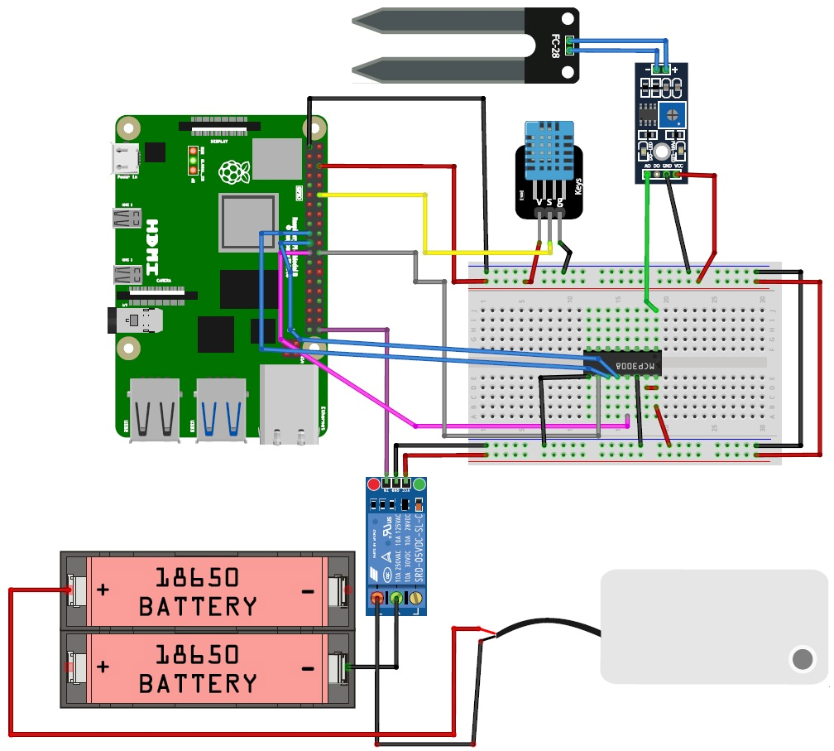
Hardware Schematic
DHT11 sensor interfaces serially with GPIO 18
Moisture sensor interfaces with the mcp3008, and the output of the ADC value is read through SPI communication.
Pin 21 is a digital output connected to a relay which is then connected to the pump.

Slide 14
Methodology
02
Communication protocols

Slide 15
Communication protocols
HTTP
MQTT
Message Queues
Used in sending a get request to the Blynk server to get the button values to the Blynk python script
used for communication between the python script and Adafruit server to publish the sensor values to Adafruit platform.
Used in sending the values of the buttons on received by the Blynk script to the python script of the hardware and Adafruit
Notes:
HTTP:
The python script initiates a connection with the Blynk server by using the IP after resolving it from the DNS, it then establishes a TCP connection with the Blynk server. After establishing the connection, the request of the python script is sent as packets to the Blynk server which then authenticates the sender and performs the required action (returns the button state) in our case.
MQTT:
MQTT (Message Queuing Telemetry Transport) is a lightweight messaging protocol, in this project we used it in communicating between Adafruit and the python script controlling the hardware. This protocol was used to send data (sensor values and indicators) from the Python script (client) to Adafruit IO broker which is a server that implements the MQTT protocol and is hosted by Adafruit. The script publishes messages/values to a specific topic and each topic acts as a channel within feeds. The subscriber is used to receive data from the Adafruit to the python script. 5
The TLS (Transport Layer Security) is used to encrypt data transmitted between devices and the broker. The MQTT uses both TCP/IP and utilizes a client-server model for communication. The python script acts as a MQTT client and initiates a connection to the MQTT broker, then handshaking and authentication are applied to authenticate the client using the username, password, and token. Then publishing and subscribing messages can take place where the broker is used to forward the messages to the correct place. The broker stores the sent messages temporarily and forwards them to the subscribed clients.
Message Queues:
The message queues provide a way to exchange data without directly sharing memory. In this project, it is used to communicate the value of 2 buttons from the blynk application python script to the Adafruit python script. The first step is queue creation, which is identified by a unique key and provides mechanisms for sending and receiving messages. The placing of data into the message queue initializes the sending of data. The receiver reads messages from the queue using the same key. Message queues are managed by the OS kernel, it handles the queuing, buffering, and synchronization of data between the processes.

Slide 16
Workflow
03

Slide 17
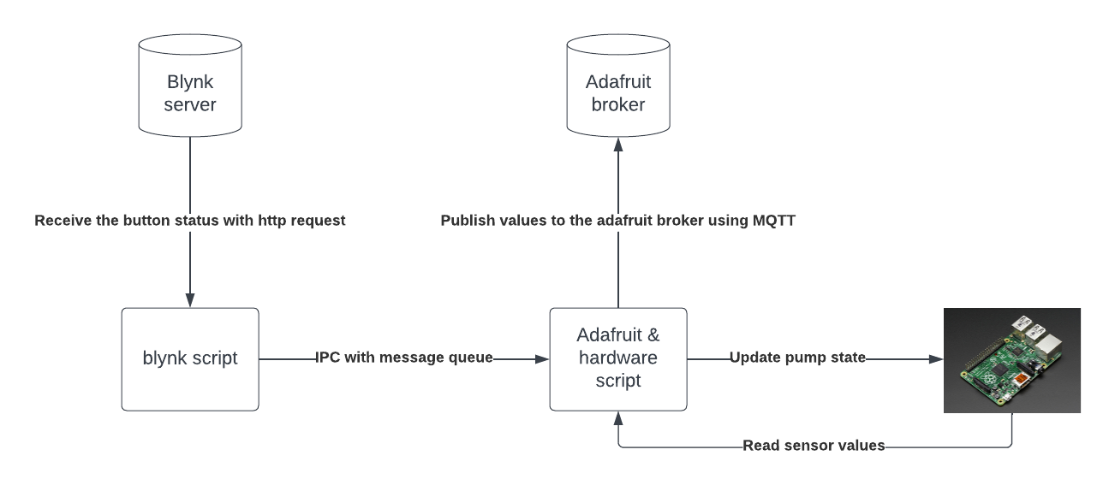
Block diagram of Communication
Notes:
Adafruit API
Authentication: You'll typically need an API key generated from your Adafruit IO account to authenticate your requests.
Endpoints: Adafruit IO offers endpoints for various functionalities such as:
Sending data from devices (POST requests to feeds).
Retrieving data from feeds (GET requests).
Managing feeds, groups, dashboards, etc.
Blynk API:
Authentication: Similar to Adafruit, you'll need an authentication token generated from your Blynk account to authenticate API requests.
Endpoints: Blynk's API allows actions such as:
Reading and writing virtual pin values.
Controlling hardware remotely.
Sending notifications, emails, etc.

Slide 18
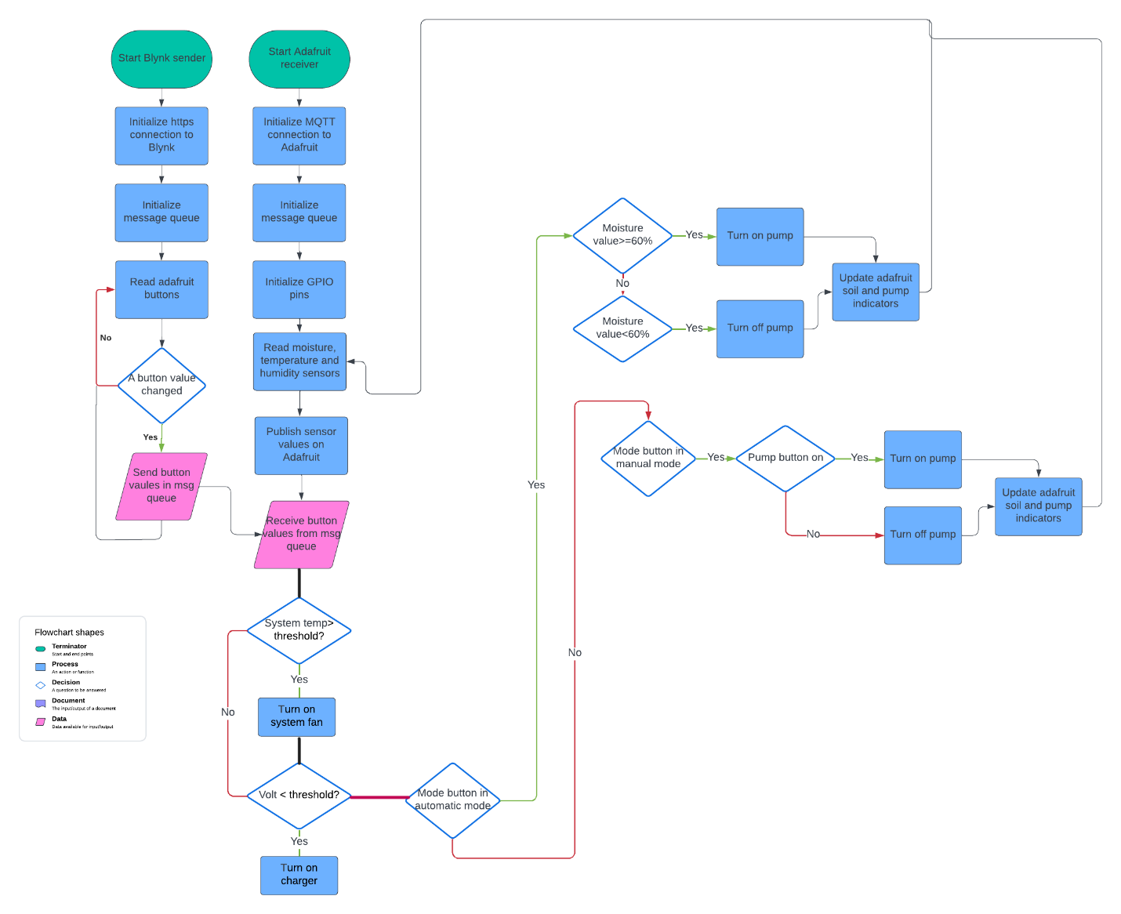
Flowchart

Slide 19
Results
04

Slide 20
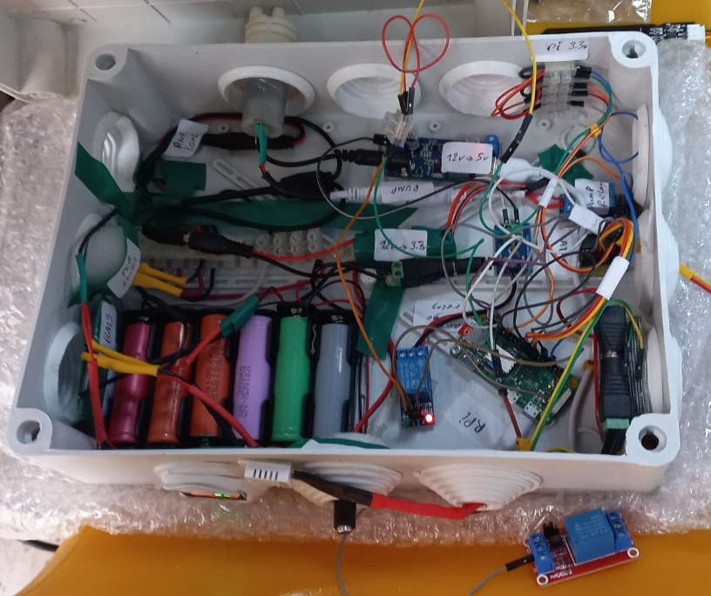

Slide 21
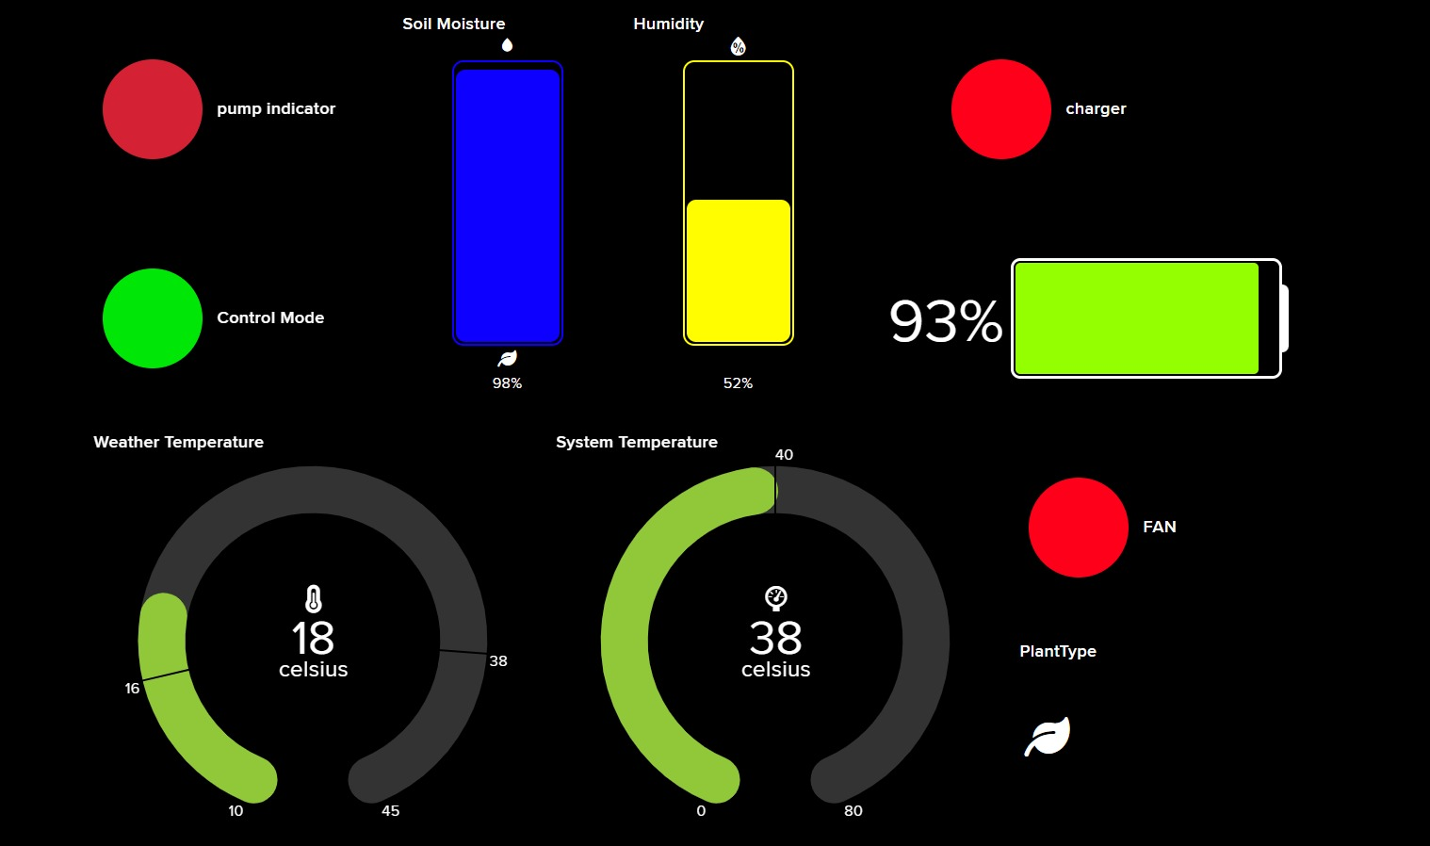
Adafruit

Slide 22
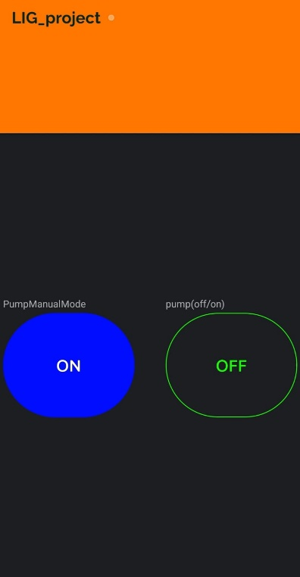
Blynk Application
The button used for manual control controls the operational mode of the project, Off -> Manual mode, ON -> Automatic mode
The green button is only for controlling the pump manually, it is only enabled in manual mode.

Slide 23
Cost
Components | Price
RaspberryPi Zero | 2200 L.E
Battery 12v 10000mAh | 250 L.E
DS1307 RTC (Real Time Clock) for Raspberry Pi
BMS 3S (12.6V – 100A) Lithium Battery Protection Module | 210 L.E
dc step down converter variable 3a 24v 12v to 5v 5a power module | 150 L.E
Relay Module (12V-10A) 1Channel (Low level trigger) | 30 L.E
Voltage and current sensor module consume | 100 L.E
Waterproof Electrical Box IP65 (30(L) x 25(W) x 12(H) cm) | 110 L.E
Battery Level Indicator Module 1S-8S (General Version) | 60 L.E
pump | 75 L.E
DHT11 | 48 L.E
wiring | 70 L.E
Soil moisture sensor | 75 L.E
Total | 3378 L.E = 110 $

Slide 24
Basic Financial plan

Slide 25
comparison between our project and the similar products in the market
 | Our project | Kollea Reliable Automatic Watering System [2] | RAINTPOINT Automatic Watering System [3] | MARS HYDRO Auto Drip Irrigation Kits [4]
Cost | 140 $ (this is the cost + the profit) | 50 $ | 55 $ | 140$
Number of plants | 8 plants with some modifications | 8 | 8 | 8
Automatic | Yes | Yes It waters on intervals of time | Yes It waters on intervals of time | Yes It waters on intervals of time
Manual | Yes | No | Yes | No
Sensors | Yes | No | Yes | No

Slide 26
Thanks!

